Slide 1
Data and Algorithm 11
Chulalongkorn University
School of Integrated Innovation
Fall 2023
Marko Niinimaki Marko.N@chula.ac.th

Slide 2
Today’s main topics
Where is data? In programs/files/databases/blockchains/the web/the cloud.
From last week: JSON
What is an API?
What is cloud computing? Examples.

Slide 3
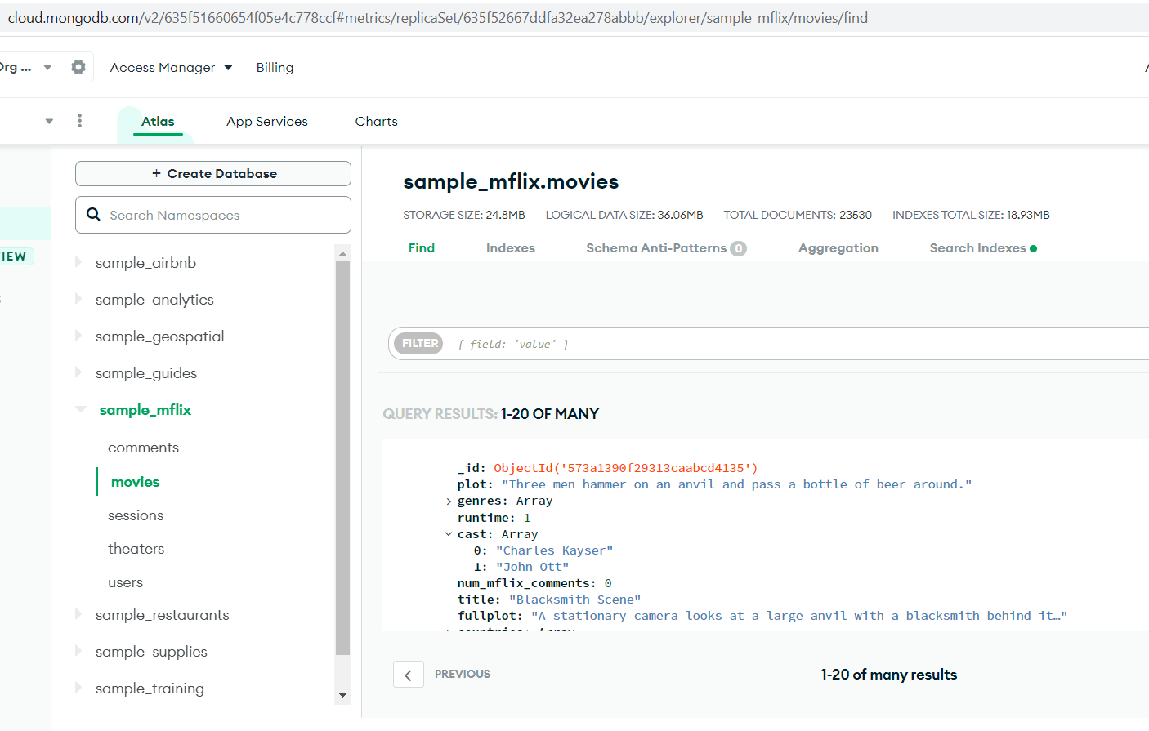
A JSON based cloud database

Slide 4
Getting data using an URL
..is often used in web technologies. Here we get a static file from a web site. But maybe there is a program at the site that runs when you call it by an URL.
This kind of collection of programs-urls is often called an Application Programming Interface (API).. And can be used in cloud computing.
import urllib.request
for line in urllib.request.urlopen("https://www.gutenberg.org/files/2701/2701-0.txt"):
print(line)
import urllib.request
import json
q_url = 'https://zenquotes.io/api/today'
with urllib.request.urlopen(q_url) as url:
data = json.loads(url.read().decode())
print(data)

Slide 5
Getting data using an URL: What is an API?
An application programming interface (API) is a way for two or more computer programs to communicate with each other.
It is a type of software interface, offering a service to other pieces of software.
A document or standard that describes how to build or use such a connection or interface is called an API specification.
A computer system that meets this standard is said to implement or expose an API. The term API may refer either to the specification or to the implementation.
Web APIs are a service accessed from client devices (mobile phones, laptops, etc.) to a web server using the Hypertext Transfer Protocol (HTTP). Client devices send a request in the form of an HTTP request, and are met with a response message usually in JavaScript Object Notation (JSON) or Extensible Markup Language (XML) format.

Slide 6
Getting data using an URL: What is an API?
Let’s try using an API:
https://scii.chula.ac.th/wp-json/wp/v2/posts
You can see that it (mostly) contains the textual content of https://scii.chula.ac.th/blog/ in the JSON format.
An API call with a parameter: get the posts that have “GIFTED” in them.
https://scii.chula.ac.th/wp-json/wp/v2/posts?search=GIFTED
“WP” in the URL means WordPress, Scii is running WordPress (as about 70% of the web sites of the world). WordPress is typically a “hosted cloud service”.

Slide 7
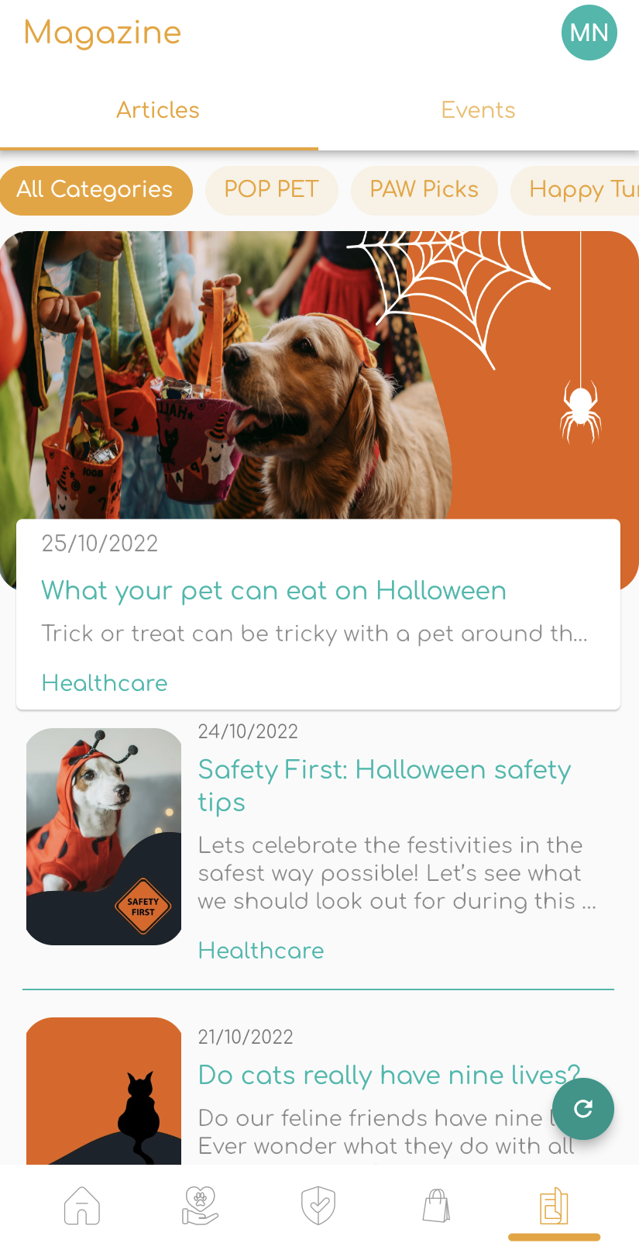
Getting data using an URL: What is an API?
Why would you use an API?
Maybe you would like to create a mobile application that shows posts from a site like scii.chula.ac.th. The application calls the API, reads the contents and renders it on the mobile phone screen.
Example:
An application that shows pet articles from a pet company site.

Slide 8
What is Cloud Computing? Just JSON services?
Where is data? In programs/files/databases/blockchains/the cloud...
Much more. The basics in 3 min (AWS as an example):
https://www.youtube.com/watch?v=mxT233EdY5c
And in 6 min
https://www.youtube.com/watch?v=36zducUX16w&ab_channel=EcourseReview
SaaS/PaaS/IaaS

Slide 9
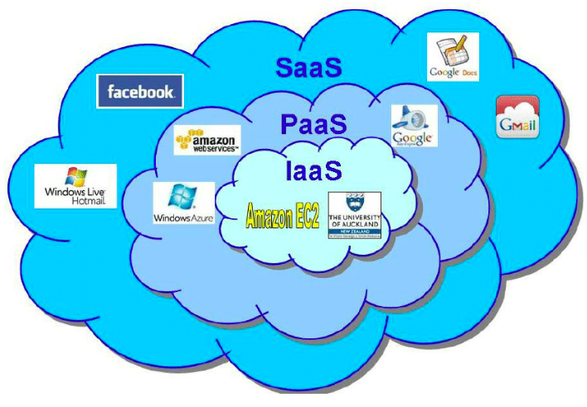
"Cloud service models"
WordPress as an example.
You get a virtual machine from a cloud provider like Amazon AWS or Google Cloud. You install and configure WordPress yourself: IaaS.
You get a ready-made WordPress installation from WordPress.com or another hosting service like GoDaddy: SaaS.
You use WordPress as an API and write applications that use the API in the cloud: PaaS.
What is a virtual machine?

Slide 10
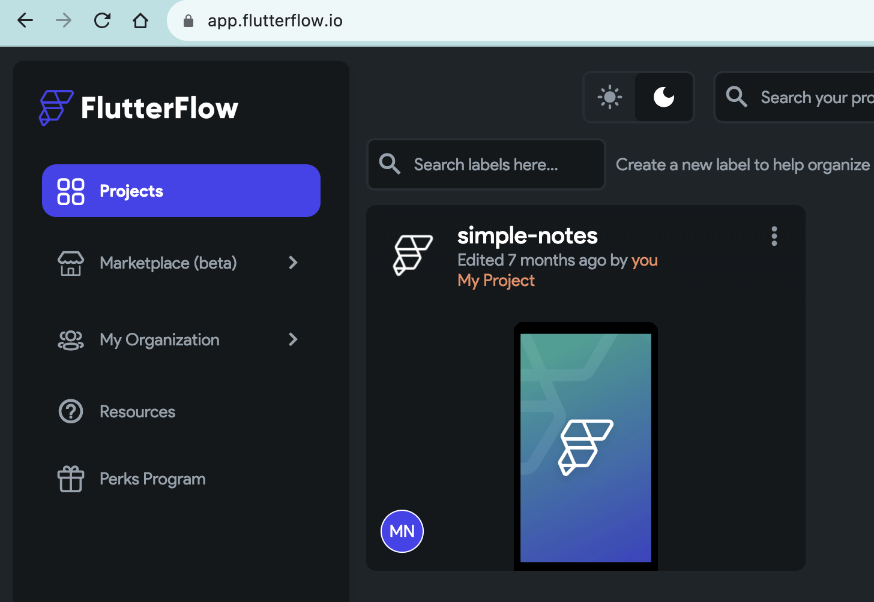
"Cloud service models"
Mildly wild platform (PaaS) example (Flutterflow): use a cloud application to create applications that run in the cloud.

Slide 11
What next?
The lab sheet Lab Week 11 DS-Big Data: MongoDB cloud database.

